Slide 1




MASTER PROGRAM IN
DATA SCIENCE AI & MACHINE LEARNING
www.mcta.co.in

Slide 2



Classification Techniques
www.mcta.co.in

Slide 3
Contents covered
Decision Tree
Entropy
Gini
Variable importance
Parent and leaf nodes
Pruning
2. Random forest
Deepdive into ensembling technique
3. KNN
K-Nearest neighbours classifier theory and example
www.mcta.co.in

Slide 4
Contents covered
4. Logistic Regression
Logit
Sigmoid
Threshold
Elbow method
5. Naïve Bayes
Learn Naïve bayes theorem to classify data
6. SVM
- Learn Support vector machine technique to classify data in n-dimensional space
www.mcta.co.in

Slide 5
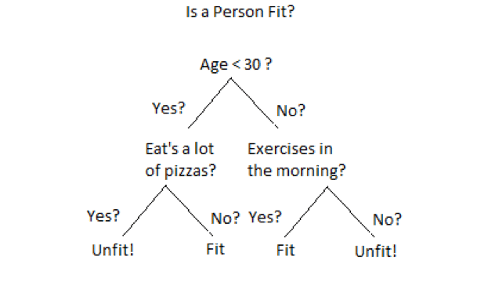
Decision Tree
Decision tree is a classification algorithm that tries to identify the outcome of the data by splitting it into every possible outcome
It works on the if/then principle
Below diagram illustrates how decision tree works in the backend
We can see that each node represents an attribute or feature and the branch from each node represents the outcome of that node. Finally, its the leaves of the tree where the final decision is made.
www.mcta.co.in

Slide 6
Decision Tree
A general algorithm for a decision tree can be described as follows:
1. Pick the best attribute/feature. The best attribute is one which best splits or separates the data
2. Ask the relevant question
3. Follow the answer path
4. Go to step 1 until you arrive to the answer
Below are attributes used to test the decision tree model
Entropy –
The randomness of the data is called entropy, the higher the entropy the more generalized the model will be.
Entropy controls how decision tree splits the data
Gini -
Gini measures how often a randomly chosen sample will be incorrectly classified, hence lower the gini the better
www.mcta.co.in

Slide 7
Decision Tree
Feature Importance –
Feature importance gives a score for every variables in the dataset, the variables with highest score has the highest importance in decision making
Hence this technique helps in dropping variables with low importance that does not add value to model’s learning process
Parent and Leaf node –
Parent nodes are the ones that expand further into various branches while a leaf node is the final outcome and does not expand further, refer to the diagram on the next page
Pruning –
Pruning in decision tree is a technique where we remove the branches that add very less information to the model
www.mcta.co.in

Slide 8
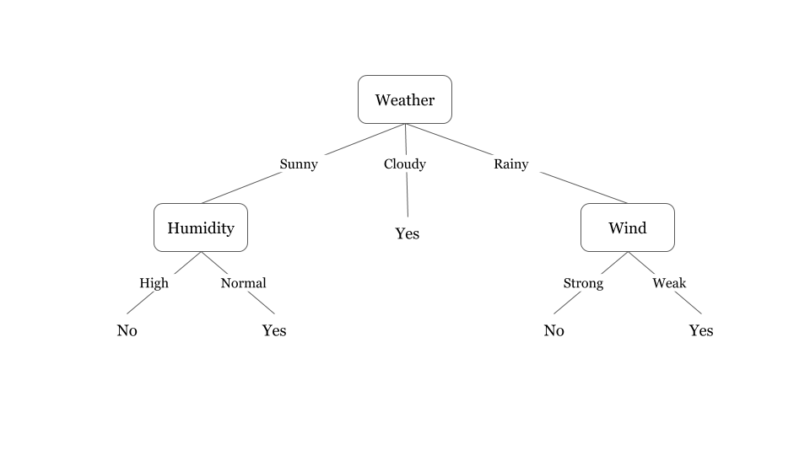
Decision Tree
Decision Tree
We can see that each node represents an attribute or feature and the branch from each node represents the outcome of that node. Finally, its the leaves of the tree where the final decision is made.
Refer to python notebook decision_tree.ipynb for python implementation
www.mcta.co.in

Slide 9
Solved example with Decision tree
www.mcta.co.in

Slide 10
Decision Tree (Solved example)
How does a Decision Tree decide where to split?
There are various ways to decide on the metric to choose the variable on which splitting for a node is done. Different algorithms deploy different metrices to decide which variable splits the dataset the the best way.
The decision of making strategic splits heavily affects a tree’s accuracy. The decision criteria is different for classification and regression trees.
Decision trees use multiple algorithms to decide to split a node in two or more sub-nodes. The creation of sub-nodes increases the homogeneity of resultant sub-nodes. In other words, we can say that purity of the node increases with respect to the target variable. Decision tree splits the nodes on all available variables and then selects the split which results in most homogeneous sub-nodes.
The algorithm selection is also based on type of target variables.
www.mcta.co.in

Slide 11
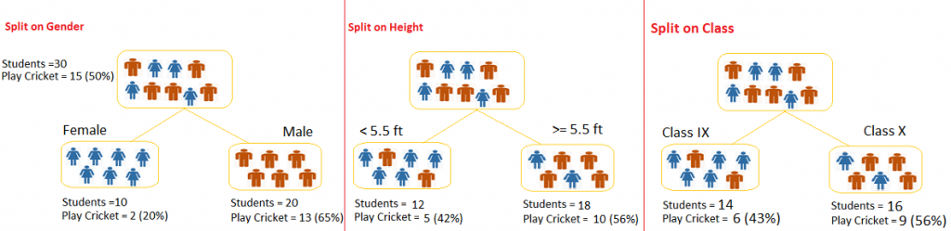
Decision Tree (Solved example)
Example:-
Let’s say we have a sample of 30 students with three variables Gender (Boy/ Girl), Class( IX/ X) and Height (5 to 6 ft). 15 out of these 30 play cricket in leisure time. We want to create a model to predict who will play cricket during leisure period? In this problem, we need to segregate students who play cricket in their leisure time based on highly significant input variable among all three.
www.mcta.co.in

Slide 12
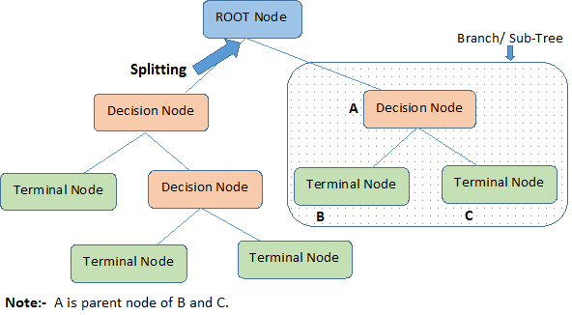
Decision Tree (Solved example)
This is where decision tree helps, it will segregate the students based on all values of three variable and identify the variable, which creates the best homogeneous sets of students (which are heterogeneous to each other). In the snapshot below, you can see that variable Gender is able to identify best homogeneous sets compared to the other two variables.
As mentioned above, decision tree identifies the most significant variable and it’s value that gives best homogeneous sets of population. Now the question which arises is, how does it identify the variable and the split? To do this, decision tree uses various algorithms, which are discussed below:
Structure of a Decision Tree:
www.mcta.co.in

Slide 13
Decision Tree (Solved example)
Gini Index
Gini index says, if we select two items from a population at random then they must be of same class and probability for this is 1 if population is pure.
- It works with categorical target variable “Success” or “Failure”.
- It performs only Binary splits
- Higher the value of Gini higher the homogeneity.
- CART (Classification and Regression Tree) uses Gini method to create binary splits.
Steps to Calculate Gini for a split
- Calculate Gini for sub-nodes, using formula sum of square of probability for success and failure (p2+q2).
Calculate Gini for split using weighted Gini score of each node of that split
Example: – Referring to example used above, where we want to segregate the students based on target variable ( playing cricket or not ). In the snapshot below, we split the population using two input variables Gender and Class. Now, I want to identify which split is producing more homogeneous sub-nodes using Gini index.
www.mcta.co.in

Slide 14
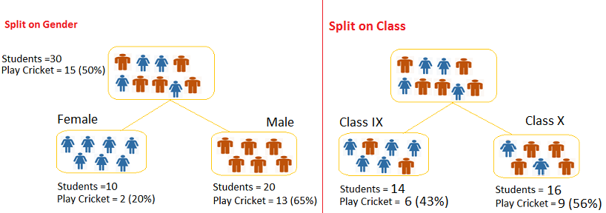
Decision Tree (Solved example)
Split on Gender:
- Calculate, Gini for sub-node Female = (0.2)(0.2)+(0.8)(0.8)=0.68
- Gini for sub-node Male = (0.65)(0.65)+(0.35)(0.35)=0.55
- Calculate weighted Gini for Split Gender = (10/30)0.68+(20/30)0.55 = 0.59
www.mcta.co.in

Slide 15
Decision Tree (Solved example)
Similar for Split on Class:
- Gini for sub-node Class IX = (0.43)(0.43)+(0.57)(0.57)=0.51
- Gini for sub-node Class X = (0.56)(0.56)+(0.44)(0.44)=0.51
- Calculate weighted Gini for Split Class = (14/30)0.51+(16/30)0.51 = 0.51
Above, you can see that Gini score for Split on Gender is higher than Split on Class, hence, the node split will take place on Gender.
Chi-Square
It is an algorithm to find out the statistical significance between the differences between sub-nodes and parent node. We measure it by sum of squares of standardized differences between observed and expected frequencies of target variable.
It works with categorical target variable “Success” or “Failure”.
It can perform two or more splits.
Higher the value of Chi-Square higher the statistical significance of differences between sub-node and Parent node.
Chi-Square of each node is calculated using formula,
Chi-square = ((Actual – Expected)^2 / Expected)^1/2
It generates tree called CHAID (Chi-square Automatic Interaction Detector)
www.mcta.co.in

Slide 16
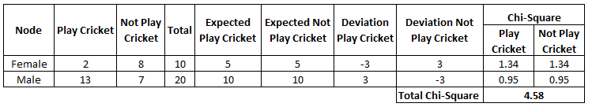
Decision Tree (Solved example)
Steps to Calculate Chi-square for a split:
- Calculate Chi-square for individual node by calculating the deviation for Success and Failure both
- Calculated Chi-square of Split using Sum of all Chi-square of success and Failure of each node of the split
Example: Let’s work with above example that we have used to calculate Gini.
Split on Gender:
First we are populating for node Female, Populate the actual value for “Play Cricket” and “Not Play Cricket”, here these are 2 and 8 respectively.
Calculate expected value for “Play Cricket” and “Not Play Cricket”, here it would be 5 for both because parent node has probability of 50% and we have applied same probability on Female count(10).
Calculate deviations by using formula, Actual – Expected. It is for “Play Cricket” (2 – 5 = -3) and for “Not play cricket” ( 8 – 5 = 3).
Calculate Chi-square of node for “Play Cricket” and “Not Play Cricket” using formula with formula, = ((Actual – Expected)^2 / Expected)^1/2. You can refer below table for calculation.
Follow similar steps for calculating Chi-square value for Male node.
Now add all Chi-square values to calculate Chi-square for split Gender.
www.mcta.co.in

Slide 17
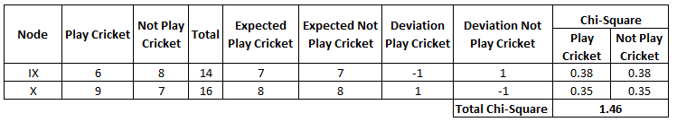
Decision Tree (Solved example)
Split on Class:
Perform similar steps of calculation for split on Class and you will come up with below table.
Above, you can see that Chi-square also identify the Gender split is more significant compare to Class.
www.mcta.co.in

Slide 18
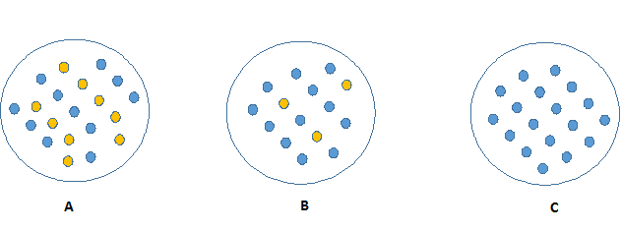
Decision Tree (Solved example)
Information Gain:
Look at the image below and think which node can be described easily. I am sure, your answer is C because it requires less information as all values are similar. On the other hand, B requires more information to describe it and A requires the maximum information. In other words, we can say that C is a Pure node, B is less Impure and A is more impure.
Now, we can build a conclusion that less impure node requires less information to describe it. And, more impure node requires more information. Information theory is a measure to define this degree of disorganization in a system known as Entropy. If the sample is completely homogeneous, then the entropy is zero and if the sample is an equally divided (50% – 50%), it has entropy of one.
www.mcta.co.in

Slide 19
Decision Tree (Solved example)
Entropy can be calculated using formula:
Entropy = −plog2p−qlog2q
Here p and q is probability of success and failure respectively in that node. Entropy is also used with categorical target variable. It chooses the split which has lowest entropy compared to parent node and other splits. The lesser the entropy, the better it is.
Steps to calculate entropy for a split:
Calculate entropy of parent node
Calculate entropy of each individual node of split and calculate weighted average of all sub-nodes available in split.
www.mcta.co.in

Slide 20
Decision Tree (Solved example)
Example: Let’s use this method to identify best split for student example.
Entropy for parent node = -(15/30) log2 (15/30) – (15/30) log2 (15/30) = 1. Here 1 shows that it is a impure node.
Entropy for Female node = -(2/10) log2 (2/10) – (8/10) log2 (8/10) = 0.72 and for male node, -(13/20) log2 (13/20) – (7/20) log2 (7/20) = 0.93
Entropy for split Gender = Weighted entropy of sub-nodes = (10/30)*0.72 + (20/30) * 0.93 = 0.86
Entropy for Class IX node, -(6/14) log2 (6/14) – (8/14) log2 (8/14) = 0.99 and for Class X node, -(9/16) log2 (9/16) – (7/16) log2 (7/16) = 0.99
Entropy for split Class = (14/30) * 0.99 + (16/30) * 0.99 = 0.99
Above, you can see that entropy for Split on Gender is the lowest among all, so the tree will split on Gender. We can derive information gain from entropy as 1- Entropy.
www.mcta.co.in

Slide 21
Decision Tree (Solved example)
Reduction in Variance
Till now, we have discussed the algorithms for categorical target variable. Reduction in variance is an algorithm used for continuous target variables (regression problems). This algorithm uses the standard formula of variance to choose the best split. The split with lower variance is selected as the criteria to split the population:
Variance = ∑(X−X¯)2n
Above X¯ is mean of the values, X is actual and n is number of values.
Steps to calculate Variance:
Calculate variance for each node.
Calculate variance for each split as weighted average of each node variance.
Example:- Let’s assign numerical value 1 for play cricket and 0 for not playing cricket. Now follow the steps to identify the right split:
www.mcta.co.in

Slide 22
Decision Tree (Solved example)
- Variance for Root node, here mean value is (151 + 150)/30 = 0.5 and we have 15 one and 15 zero. Now variance would be ((1-0.5)^2+(1-0.5)^2+….15 times+(0-0.5)^2+(0-0.5)^2+…15 times) / 30, this can be written as (15(1-0.5)^2+15(0-0.5)^2) / 30 = 0.25
- Mean of Female node = (21+80)/10=0.2 and Variance = (2(1-0.2)^2+8(0-0.2)^2) / 10 = 0.16
- Mean of Male Node = (131+70)/20=0.65 and Variance = (13(1-0.65)^2+7(0-0.65)^2) / 20 = 0.23
- Variance for Split Gender = Weighted Variance of Sub-nodes = (10/30)*0.16 + (20/30) * 0.23 = 0.21
- Mean of Class IX node = (61+80)/14=0.43 and Variance = (6(1-0.43)^2+8(0-0.43)^2) / 14= 0.24
- Mean of Class X node = (91+70)/16=0.56 and Variance = (9(1-0.56)^2+7(0-0.56)^2) / 16 = 0.25
- Variance for Split Gender = (14/30)*0.24 + (16/30) * 0.25 = 0.25
Above, you can see that Gender split has lower variance compare to parent node, so the split would take place on Gender variable.
www.mcta.co.in

Slide 23
Random Forest
www.mcta.co.in

Slide 24
Random Forest
Random forest in an ensemble of decision tree, meaning its a modified version of decision tree creates multiple decision trees and outputs the mean score
The random forest is a model made up of many decision trees. Rather than just simply averaging the prediction of trees (which we could call a “forest”), this model uses two key concepts that gives it the name random:
Random sampling of training data points when building trees
Random subsets of features considered when splitting nodes
Random sampling of training observations
When training, each tree in a random forest learns from a random sample of the data points. The samples are drawn with replacement, known as bootstrapping, which means that some samples will be used multiple times in a single tree. The idea is that by training each tree on different samples, although each tree might have high variance with respect to a particular set of the training data, overall, the entire forest will have lower variance but not at the cost of increasing the bias.
At test time, predictions are made by averaging the predictions of each decision tree. This procedure of training each individual learner on different bootstrapped subsets of the data and then averaging the predictions is known as bagging, short for bootstrap aggregating.
www.mcta.co.in

Slide 25
Random Forest
Random subsets of features considered when splitting nodes
Random Subsets of features for splitting nodes
The other main concept in the random forest is that only a subset of all the features are considered for splitting each node in each decision tree. Generally this is set to sqrt(n_features) for classification meaning that if there are 16 features, at each node in each tree, only 4 random features will be considered for splitting the node. (The random forest can also be trained considering all the features at every node as is common in regression. These options can be controlled in the Scikit-Learn Random Forest implementation).
Refer to python notebook random_forest.ipynb for python implementation
www.mcta.co.in

Slide 26
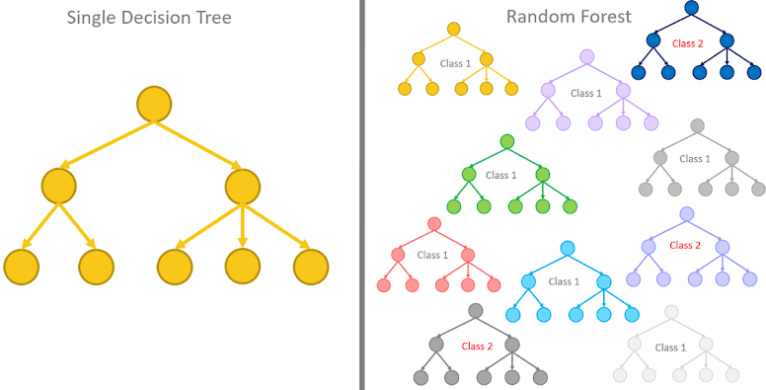
Random Forest
Below diagram represents the difference in Decision Tree and Random Forest
www.mcta.co.in

Slide 27
KNN
www.mcta.co.in

Slide 28
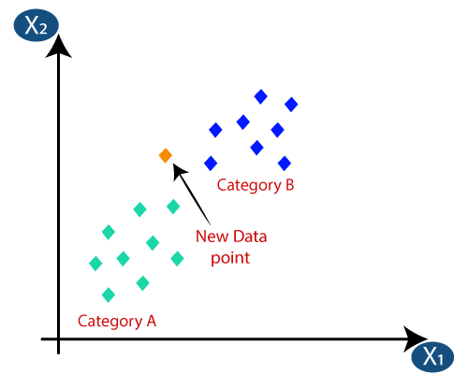
KNN
KNN-
K-nearest neighbors is form of classification technique where n-number of groups are formed and any new data point will belong to the nearest group on the graph
The diagram below illustrates KNN in practice
As shown in the diagram, the new data point will belong to Category B since its closest to that category
Refer to file for knn.ipynb for implementation in python
www.mcta.co.in

Slide 29
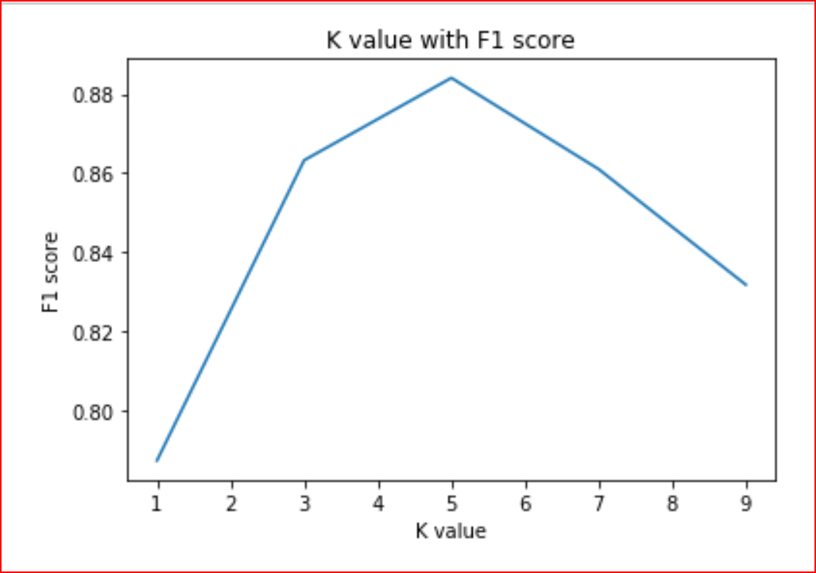
KNN
How do we chose the value of K?
Choice of K has a drastic impact on the results we obtain from KNN.
we can take the test set and plot the accuracy rate or F1 score against different values of K.
We see a high error rate for test set when K=1. Hence we can conclude that model overfits when k=1.
For a high value of K, we see that the F1 score starts to drop. The test set reaches a minimum error rate when k=5. This is very similar to the elbow method used in K-means.
Value of K at the elbow of test error rate gives us the optimal value of K.
www.mcta.co.in

Slide 30
KNN
How do we chose the value of K?
Choice of K has a drastic impact on the results we obtain from KNN.
we can take the test set and plot the accuracy rate or F1 score against different values of K.
We see a high error rate for test set when K=1. Hence we can conclude that model overfits when k=1.
For a high value of K, we see that the F1 score starts to drop. The test set reaches a minimum error rate when k=5. This is very similar to the elbow method used in K-means.
Value of K at the elbow of test error rate gives us the optimal value of K.
How does KNN work?
We have age and experience in an organization along with the salaries. We want to predict the salary of a new candidate whose age and experience is available.
Step 1: Choose a value for K. K should be an odd number.
Step2: Find the distance of the new point to each of the training data.
Step 3:Find the K nearest neighbors to the new data point.
Step 4: For classification, count the number of data points in each category among the k neighbors. New data point will belong to class that has the most neighbors.
www.mcta.co.in

Slide 31
KNN
How is the distance calculated?
Distance can be calculated using
- Euclidean distance
- Manhattan distance
- Hamming Distance
- Minkowski Distance
Euclidean distance is the square root of the sum of squared distance between two points. It is also known as L2 norm.
Manhattan distance is the sum of the absolute values of the differences between two points
www.mcta.co.in

Slide 32
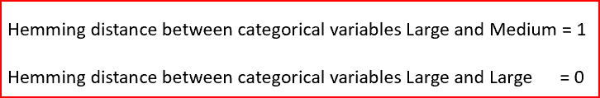

KNN
Hamming distance is used for categorical variables. In simple terms it tells us if the two categorical variables are same or not.
Minkowski distance is the used to find distance similarity between two points. When p=1, it becomes Manhattan distance and when p=2, it becomes Euclidean distance
www.mcta.co.in

Slide 33
Logistics Regression
www.mcta.co.in

Slide 34

Logistic Regression
Logistic regression is a form of regression model used for classification unlike linear regression which is used for predicting continuous values
The following terms are used in logistic regression model that help with indepth understanding, they are listed below
Logit Function
Logistic regression can be expressed as:
where, the left hand side is called the logit or log-odds function, and p(x)/(1-p(x)) is called odds.
The odds signifies the ratio of probability of success to probability of failure. Therefore, in Logistic Regression, linear combination of inputs are mapped to the log(odds) - the output being equal to 1.
If we take an inverse of the above function, we get:
www.mcta.co.in

Slide 35
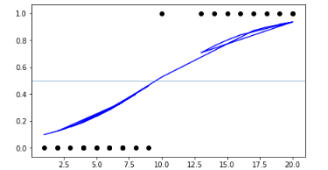
Logistic Regression
This is known as the Sigmoid function and it gives an S-shaped curve. It always gives a value of probability ranging from 0<p<1.
www.mcta.co.in

Slide 36
Logistic Regression
Threshold –
The output of the logistic regression model is in the form of threshold value between 0 to 1
We can adjust the threshold value according to business needs to classify a given sample
For example, we will consider the weather hot if and only if the probability of hot is greater than 0.70 or >70%
Refer to python notebook logistic_regression.ipynb for python implementation
www.mcta.co.in

Slide 37
Naïve Bayes
www.mcta.co.in

Slide 38
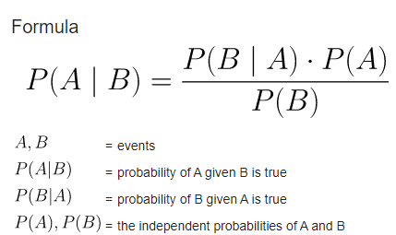
Naïve Bayes
Naive Bayes classifiers are a collection of classification algorithms based on Bayes’ Theorem. It is not a single algorithm but a family of algorithms where all of them share a common principle, i.e. every pair of features being classified is independent of each other.
Naïve bayes works on the principle of prior and posterior probability
Any new sample will be classified keeping in mind it the hypothesis or a condition at hand
For example, the probability of having cancer given we have headace, refer to the equation below
Refer to ‘naïve_bayes.ipynb’ for python implementation
www.mcta.co.in

Slide 39
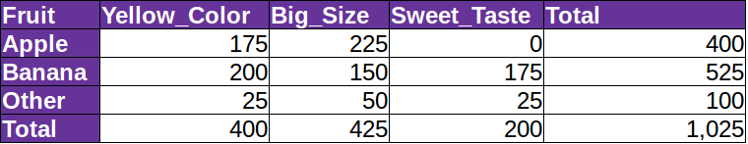
Naïve Bayes
Solved example
Let us take an example to understand how does Naive Bayes Algorithm work.
Suppose we have a training dataset of 1025 fruits.The feature in the dataset are these : Yellow_color,Big_Size,Sweet_Taste.There are three different classes apple,banana & others.
Step 1: Create a frequency table for all features against all classes
What can we conclude from the above table?
- Out of 1025 fruits, 400 are apples, 525 are bananas, and 100 are others.
- 175 of the total 400 apples are Yellow and the rest are not and so on.
- 400 fruits are Yellow, 425 are big in size and 200 are sweet from a total of 600 fruits.
www.mcta.co.in

Slide 40
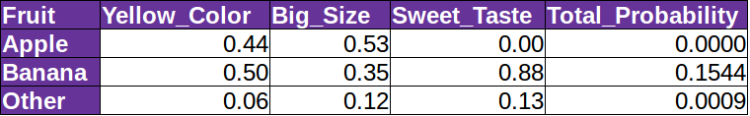
Naïve Bayes
Step 2: Draw the likelihood table for the features against the classes
In our likelihood table Total_Probability of banana is maximum(0.1544) when the fruit is of Yellow_Color,Big in size and Sweet in taste.Therefore as per Naive Bayes algorithm a fruit which is Yellow in color,big in size and sweet in taste is Banana.
In a nutshell, we say that a new element will belong to the class which will have the maximum conditional probability described above.
www.mcta.co.in

Slide 41
Support vector machine
www.mcta.co.in

Slide 42
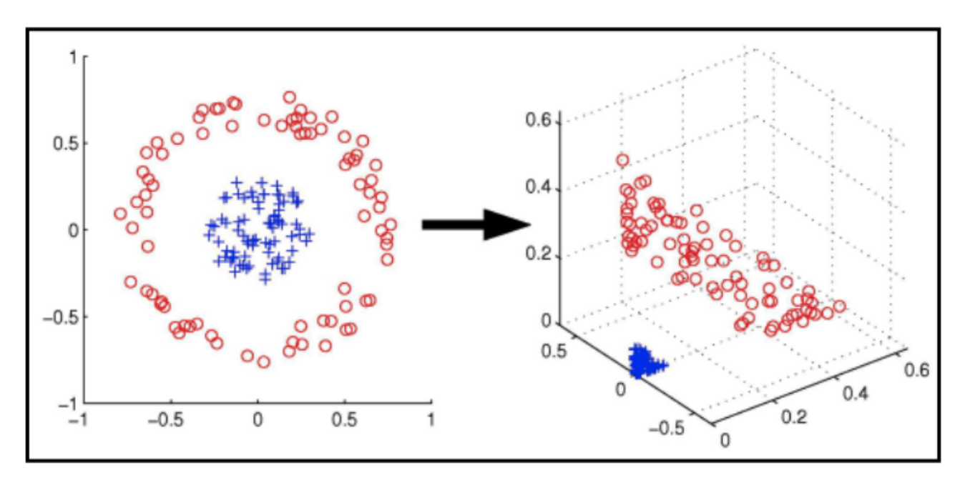
Support vector machine
Support vector machines (SVMs) are a popular linear classifier, the current version of which was developed by Vladimir Vapnik and Corinna Cortes. SVMs are supervised learning models, meaning sample data must be labeled, that can be applied to almost any type of data.
They are especially effective at classification, numeral prediction, and pattern recognition tasks. SVMs find a line (or hyperplane in dimensions greater than 2) in between different classes of data such that the distance on either side of that line or hyperplane to the next-closest data points is maximized.
www.mcta.co.in

Slide 43
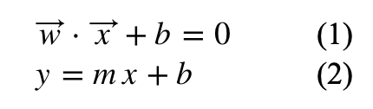
Support vector machine
In other words, support vector machines calculate a maximum-margin boundary that leads to a homogeneous partition of all data points. This classifies an SVM as a maximum margin classifier.
In other words, support vector machines calculate a maximum-margin boundary that leads to a homogeneous partition of all data points. This classifies an SVM as a maximum margin classifier.
On the edge of either side of a margin lies sample data labeled as support vectors, with at least 1 support vector for each class of data. These support vectors represent the bounds of the margin, and can be used to construct the hyperplane bisecting that margin.
Equations 2 and 1 represent the formulas for a line or hyperplane respectively. For all sample data x, an SVM should find weights such that the data points will be separated according to a decision rule. To elaborate, lets assume we have a set of negative and positive values in a two-dimensional euclidean space, along with an initial straight line (drawn in green) between the two classes of data points:
www.mcta.co.in

Slide 44
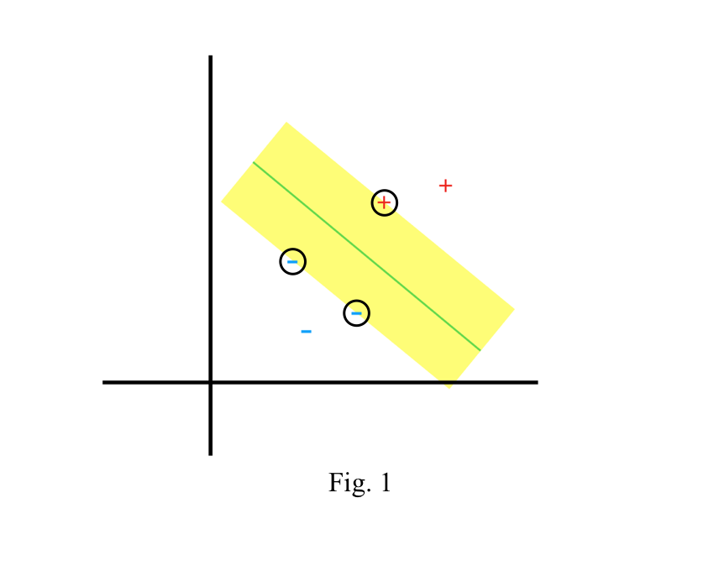
Support vector machine
The yellow space in Fig. 1 shows the margin between the points of opposing classes that are closest to each other. The sample points that are circled are the support vectors.
Now, we imagine a vector w, of arbitrary length constrained to be perpendicular to the median of that margin. Then, we take an unknown vector u, and we want to determine whether it is on the + or the - side of the margin. To do this, we project u onto our perpendicular vector w, which gives us the distance to w
www.mcta.co.in

Slide 45
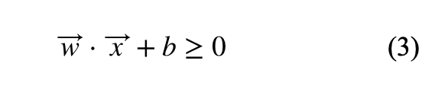
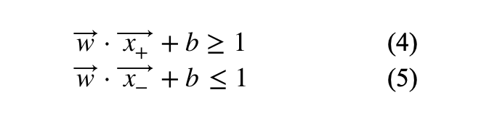
Support vector machine
Since w is perpendicular to the median, we know that the further we expand w, the closer we are to being on the + side of the margin. This means taking the dot product of our vectors u and w and checking whether it is greater than or equal to some constant, c. From here we have a decision rule, stating that if the equation
is satisfied, the sample must be of the + class. At this point, we still don’t know what b or w is. Now we need to apply additional constraints to allow us to calculate them.
If we replace u in equation 3 with a sample we know to be positive, then with a sample we know to be negative, those equations must be greater than or equal to 1 and less than or equal to -1, respectively.
www.mcta.co.in

Slide 46
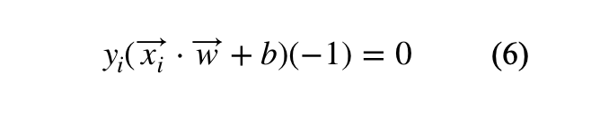
Support vector machine
For convenience, we can introduce a new variable y such that y = 1 for positive samples and y = -1 for negative samples. This converts equations 4 and 5 into one equation
Equation 6 should hold for any samples that are classified as support vectors.
Since our initial goal was to establish a margin that is as wide as possible, we must determine a way to express the distance between the boundaries of the margin.
Let’s draw two vectors from the origin to support vectors in our negative and positive classes, labeling them as x- and x+, respectively. Then we can draw a third vector between x- and x+ to show the distance vector between the two. Now we have enough vectors to calculate width by taking the dot product of our distance vector and our perpendicular vector w, then dividing by the magnitude of w.
www.mcta.co.in

Slide 47
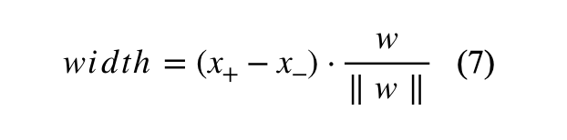
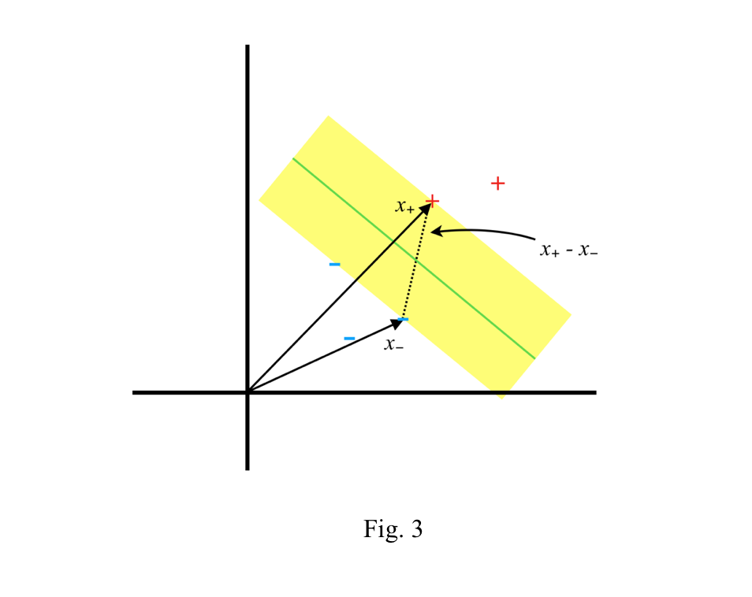
Support vector machine
Let’s draw two vectors from the origin to support vectors in our negative and positive classes, labeling them as x- and x+, respectively. Then we can draw a third vector between x- and x+ to show the distance vector between the two. Now we have enough vectors to calculate width by taking the dot product of our distance vector and our perpendicular vector w, then dividing by the magnitude of w.
www.mcta.co.in

Slide 48
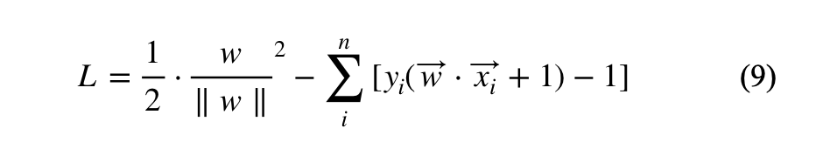
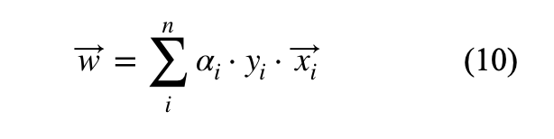
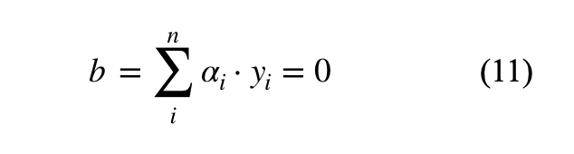
Support vector machine
To maximize equation 8, a function with constraints, we must use LaGrange multipliers. This will provide us a new function to maximize without needing to consider the constraints.
First, we differentiate L with respect to w and find that the vector w is a linear linear sum of all or some of the samples.
Differentiating L with respect to b gives:
www.mcta.co.in

Slide 49
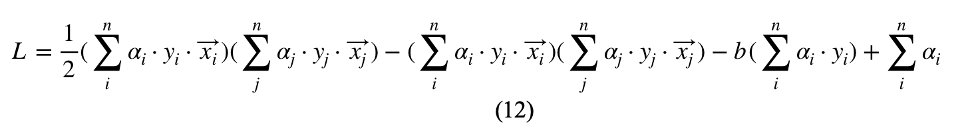
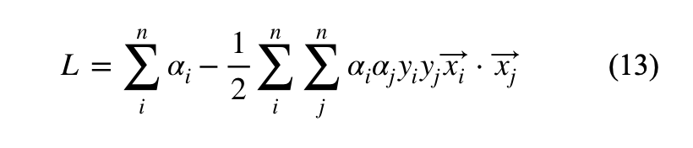
Support vector machine
Plugging our value for w in equation 10 into equation 9, we end up with equation 12.
Further reduction gives us
If the result for equation 14 is ≥ 0, our sample is in the + class.
www.mcta.co.in

Slide 50
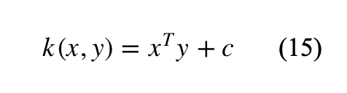
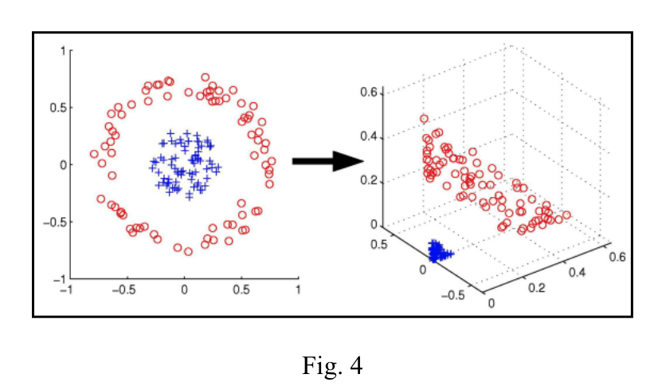
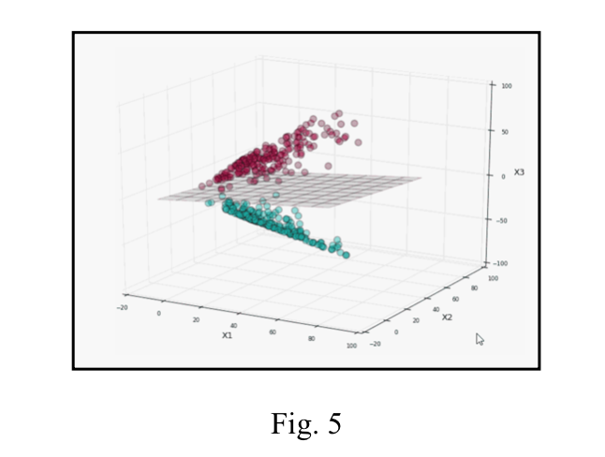
Support vector machine
So far we’ve examined cases in which our classes of sample points are linearly separable.
In the case that our sample points are not linearly separable, we must do a transformation into a new space. This is accomplished with the use of a kernel function.
Kernel functions can provide us with the dot product of two vectors in a new space without us needing to know the transformation into that space. The most simple kernel function is the linear kernel, shown as equation 15.
www.mcta.co.in

Slide 51
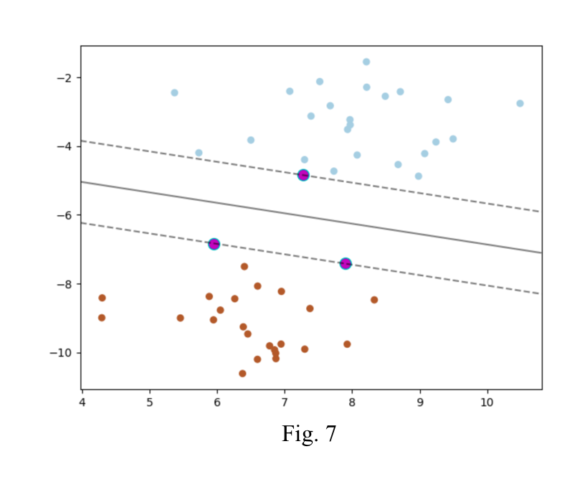
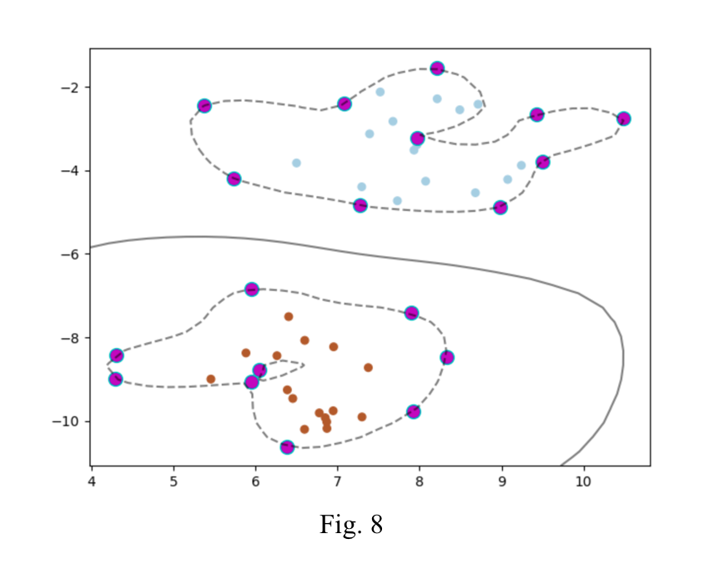
Support vector machine
Figure 4 shows an example of two classes of data that are non-linearly separable in two dimensions, but become separable once they are transformed to a three-dimensional space.
Figure 5 shows a hyperplane separating two classes of data in three dimensions.
Current machine learning libraries such as Scikit-Learn or TensorFlow allow us implement SVMs while obscuring much of the complex math.
Figure 6 shows a slightly modified example of a SVM implemented in Python with ScikitLearn. Figure 7 displays the result using the Matplotlib library.
Much of the code shown in figure 6 is housekeeping to correctly plot our result, but some areas of interest exist in lines 11 and 26. Line 11 invokes Scikit-learn’s SVM tool, which takes a kernel type and penalty parameter C of the error term as parameters. Line 26 feeds our sample data to the SVM decision function.
www.mcta.co.in

Slide 52
Support vector machine
Figure 8 shows the result of running the code with the radial basis function as the kernel. The radial basis function separates the two classes of data by setting the samples that represent the outer bounds of each class as the support vectors.
Vladimir Vapnik’s research demonstrated the groundbreaking ability to classify data in infinite dimensions using SVMs, and they remain one of the most powerful classification tools for a variety of machine learning tasks.
Though his original concepts were conceived in the early 1960’s, it took the advent of modern computers to allow his concepts to be thoroughly tested and implemented. In the early 1990’s Vapnik was able to prove his prediction that SVMs provided a better classifier than neural networks, particularly for tasks involving images, such as handwriting recognition.
Check python notebook svm.ipynb for python implementation
www.mcta.co.in

Slide 53
Supervised learning
Trivia
Please solve the following questions
Q1) What is a decision tree
Q2) What is entropy
Q3) What is Gini index and what does it say
Q4) What is Random forest and how different is it from decision tree
Q5) How does KNN work
Q6) What is logistic regression and how is it different from linear regression
Q7) What is a sigmoid function, mention the equation
Q10) What is the Naïve bayes algorithm and define the equation
Q11) What are the four kernels of support vector machines, define any 2
www.mcta.co.in

Slide 54

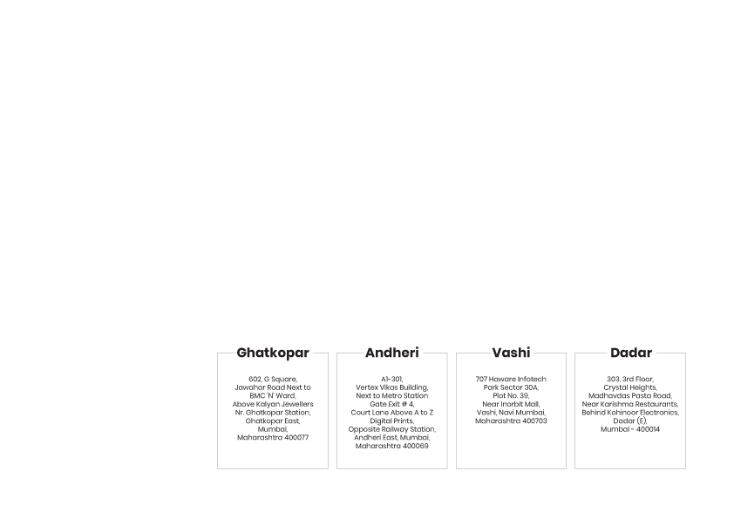
BE AN EXPERT DATA SCIENTIST!
www.mcta.co.in

